Slide 1
Introduction to Computer Programming Lecture 5.2:
Classes in Python: Inheritance
Hemma Philamore
Department of Engineering Mathematics

Slide 2



Inheritance
A child class inherits all attributes and methods of the parent class.
We can add/remove attributes and methods that are specific to the child class.
If the parent class is changed, the child class will automatically inherit the changes.
Den
__init__
__add__
Num
normalize
__mul__
eval
MyFraction
(Parent class)
__float__
__str__
Name
__init__
NamedFraction
(Child class)
sig_fig

Slide 3
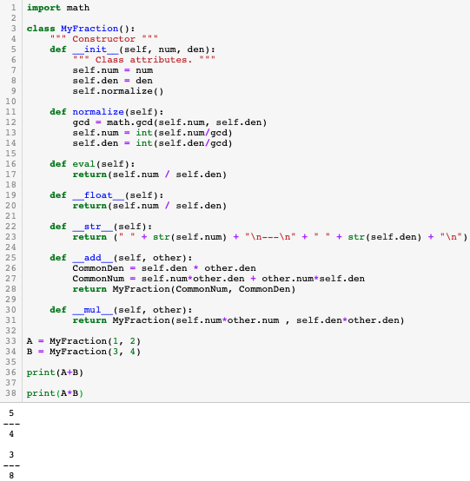
Parent class
Remember the MyFraction class
Den
__init__
__add__
Num
normalize
__mul__
eval
MyFraction
(Parent class)
__float__
__str__

Slide 4
Derive a class
Den
__init__
Num
normalize
eval
MyFraction
(Parent class)
__float__
__str__
Name
__init__
NamedFraction
(Child class)
sig_fig

Slide 5
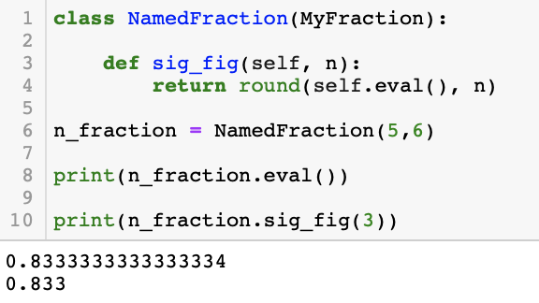
Derive from class
“MyFraction”
Den
__init__
Num
normalize
eval
MyFraction
(Parent class)
__float__
__str__
Same functionality as
“MyFraction”, eval from MyFraction class
Name
__init__
NamedFraction
(Child class)
sig_fig
New method
Notes:
Messed up creating instance of child class. Cut and retake

Slide 6
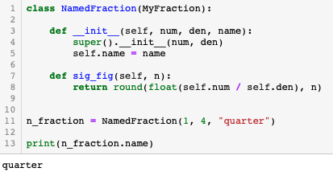
Super
Using super() followed by a dot . and then a method name allows you to call the parent's version of the method and add to it.
Initialise super class (i.e. the one that you
have derived your new class from)
Notes:
Messed up. Retake

Slide 7
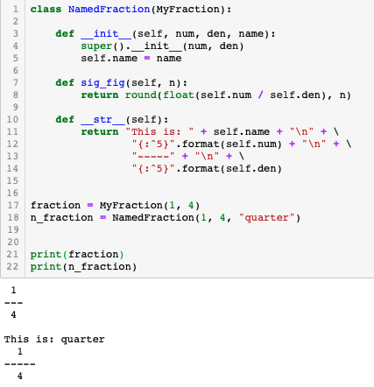
Override
Methods can be overridden by a child class to achieve different functionality.
You can override
functions for the new class
Uses the __str__ from “MyFraction”
Uses the __str__ from
“NamedFraction” instead of
“MyFraction”

Slide 8
NamedFraction is derived from MyFraction
Den
__init__
Num
normalize
eval
MyFraction
(Parent class)
__float__
Overriding init functions
(and calling super().__init__()
super()
__str__
Name
__init__
NamedFraction
(Child class)
sig_fig
Overriding functions

